Slide 1
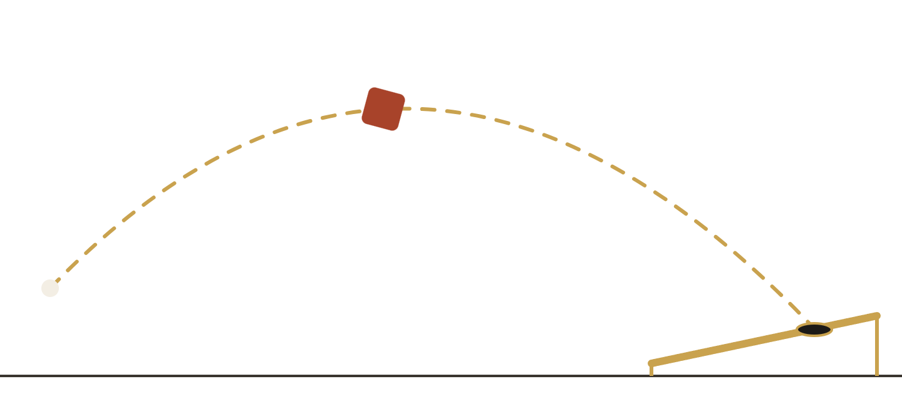
Cornhole Biomechanics Lab
ME 3890 BIOMECHANICS OF HUMAN MOVEMENT · PROJECT 1 · FALL 2026
Turning two phone videos into evidence-based coaching for Vanderbilt Athletics
Emily Park
John Wilson
Berk Kasimcan
Eliam Chang
Sport, problem and solution
Metrics and real data
App, pipeline and demo
Insights, value and lessons
Notes:
EMILY (0:10). Hi, we're the Cornhole Biomechanics Lab. Our client is the new Vanderbilt cornhole team. We built a Mac app that turns two phone videos of a throw into release physics, an outcome and one sentence of coaching.

Slide 2
Two cornhole throws can look the same and land a foot apart, yet nothing exists on the market to solve this issue.
OUR TALK
OUR ANSWER
Measure the throw, explain the miss, and coach only what the data supports.
1
2
3
4
The sport and the problem
Our solution and why
How it works: live demo
Why it will improve training
Why can't a coach see what caused a miss?
Two phones, the metrics we chose, and real athletes measured
The app pipeline, two-camera sync, and a real throw measured
What the data revealed, the evidence, and the benefit to Vanderbilt
Emily
Emily and John
Berk
Eliam
Plus: what we learned
The hardest part, what surprised us, what we would do differently, and what kept us up at night.
Cornhole Biomechanics Lab
Emily Park · 2 / 17
Notes:
EMILY (0:20). Our talk answers the four questions in the brief. One: the sport and the problem. Two: our solution and why we designed it this way, including the metrics we chose and the real athletes we measured. Three: how the system works, with a live demo. Four: why we're convinced it will improve training. And we'll finish with what we learned. Our answer in one line: measure the throw, explain the miss, and coach only what the data supports.

Slide 3
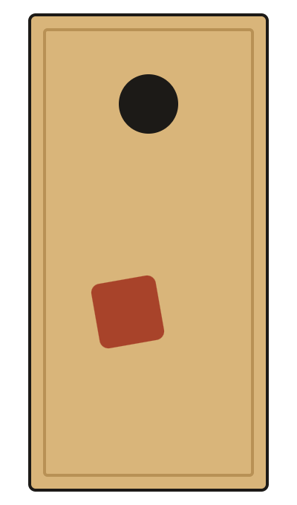
A coach sees where the bag lands, not why
PART 1 · THE SPORT AND THE PROBLEM
Small differences are invisible
Cornhole in 20 seconds
A release just 0.1 m/s faster lands about 13 cm (5 in) farther. No one can see 0.1 m/s.
The same miss can have different causes
Board 24 × 48 in, 6 in hole
Boards 27 ft apart
Hole 3, board 1, off 0
PPR = points per 4-bag round
Underhand pendulum throw
Short can mean a soft release or a short slide. Each needs a different fix.
Noise looks like signal
Every throw varies a little. Reacting to random variation leads to over-coaching.
THE COACH'S QUESTION
Once the bag leaves the hand, its release speed, angle and height decide the flight.
Which part of the throw caused this miss, and is the difference real or just noise?
Cornhole Biomechanics Lab
Emily Park · 3 / 17
Notes:
EMILY (0:35). Quick background: a regulation board is 24 by 48 inches with a 6-inch hole, 27 feet apart. Hole is 3 points, board 1, off 0, and the standard stat is points per round. The throw is an underhand pendulum swing, and once the bag leaves the hand, its speed, angle and height decide where it goes. The problem for a coach: the differences that matter are invisible (0.1 m/s is about 5 inches), the same miss can come from different causes, and some variation is just noise. So the coach's real question is: which part of this throw caused the miss, and is it real or noise?

Slide 4
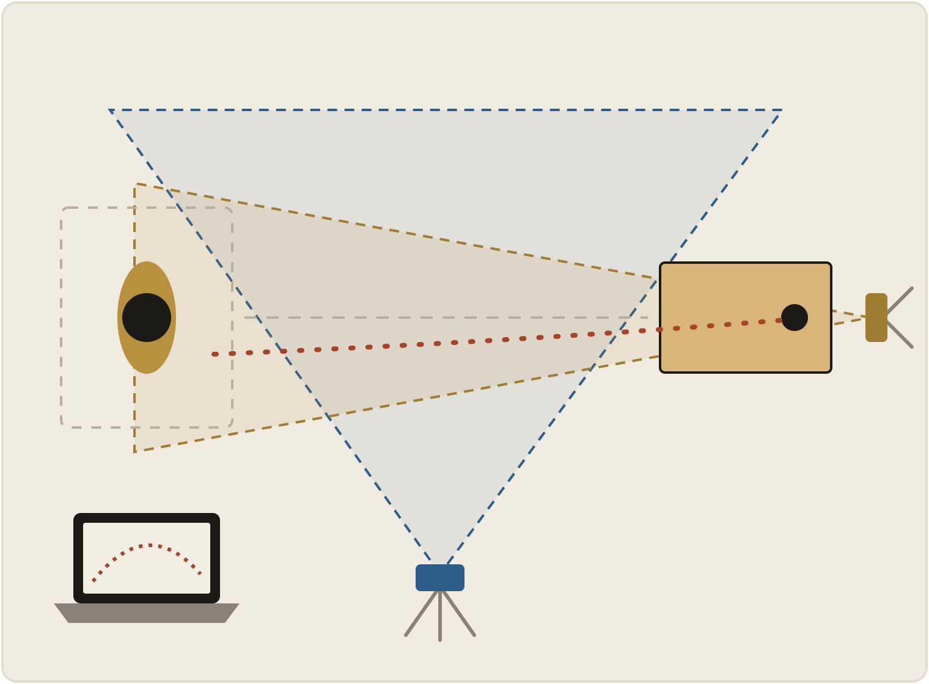
Two phones, one Mac app, no sensors on the bag
PART 2 · OUR SOLUTION AND WHY
What we use | Details
Cameras | 2 iPhones on tripods: side (60 fps) and front (30 fps)
App | Native macOS app (SwiftUI) with a Python analysis engine; runs fully on the Mac
Body model | Open-source Sports2D / RTMPose, 26 body points per frame
Coach gets | One sentence per throw, automatic hole / board / off, athlete report
Athlete
Front phone (30 fps)
Why not the alternatives?
Mac app
Motion-capture lab: accurate, but not at practice
Wearable sensors: see the arm, not the bag
Side phone (60 fps)
Sensor in the bag: not allowed by the brief
Scoring sheet: outcome only, no cause
Cornhole Biomechanics Lab
Emily Park · 4 / 17
Notes:
EMILY (0:35). Our solution uses equipment a team already owns: two iPhones on tripods and a Mac. The side phone sits beside the lane and sees the throw plane: arm swing, release speed, angle and height. The front phone sits behind the board and sees left/right and whether the bag went in the hole. The software is a native Mac app with a Python engine, using an open-source, peer-reviewed pose model. Everything runs on the laptop, so athlete video never leaves it. Why not the alternatives? A motion-capture lab is accurate but you can't bring it to practice; wearables see the arm but not the bag; a sensor in the bag isn't allowed; and a scoring sheet only gives the outcome, not the cause. John will now explain what we actually measure and why.

Slide 5

Every metric is a link from the body to the score
PART 2 · THE METRICS WE CHOSE
1 · BODY
2 · RELEASE
3 · LANDING
4 · OUTCOME
How the athlete moves
How the bag leaves the hand
What the bag does on the board
The score
Backswing angle
Forward-swing time, tempo
Trunk lean at release
Peak wrist speed
Hand path sideways
Hole / board / off
Points per round (PPR)
In / On / Off %
Release speed
Release angle
Release height
Sideways launch direction
First contact: short / long
First contact: left / right
Slide length
Where it stopped
Why: the body produces the release. Compared only with the athlete's own usual.
Why: physics. Once the bag is released, these four decide the flight.
Why: separates a miss made in the air from one made on the board.
Why: the standard stats coaches already use: the ground truth.
A metric made the cut only if:
1 physics or the sport says it affects the score · 2 a phone can measure it above its noise · 3 a coach can train it
Cornhole Biomechanics Lab
John Wilson · 5 / 17
Notes:
JOHN (0:35). The brief asks us to link how the movement is done to the outcome, so we chose metrics as a chain. Body: how the athlete moves, like backswing, tempo, trunk lean and wrist speed. Release: how the bag leaves the hand, speed, angle, height and direction. This is the most important link, because once the bag is in the air physics decides the flight. Landing: where the bag first touched and how far it slid, which tells us whether a miss happened in the air or on the board. And outcome: hole, board or off, points per round, the stats coaches already use. A metric made the cut only if physics or the sport says it matters, a phone can measure it above its noise, and a coach can actually train it.

Slide 6
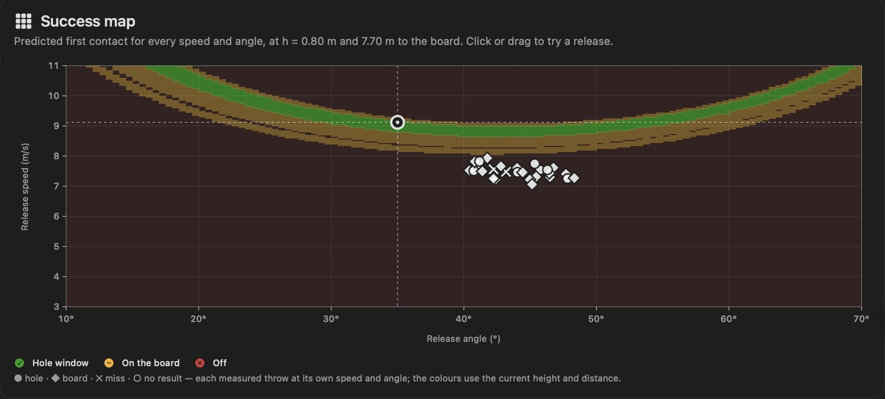
Release speed is the lever; angle is forgiving
PART 2 · HOW TO READ THE RELEASE METRICS
13 cm
Speed: the main lever
Faster than usual lands long, slower lands short. Too small to see by eye.
per 0.1 m/s
1 cm
Angle: forgiving
Our athletes release at 37–44°. Flat throwers (25–30°) are 6–9× more sensitive.
per 1° near 40°
1 cm
Height: small effect
Matters only when posture changes a lot between throws.
per 1 cm
Launch Lab success map. Green = speed and angle pairs that land in the hole window; amber = on the board. The band is wide in angle but thin in speed. Drawn at regulation distance (7.7 m).
Drag-free flight model at our typical release: 7.5 m/s, 40°, 1.0 m high, 5.7 m to the board.
Cornhole Biomechanics Lab
John Wilson · 6 / 17
Notes:
JOHN (0:35). Here is how to read the release metrics. This is the app's success map: every speed and angle combination, coloured by where a drag-free bag would land. Green is the hole window. Notice the shape: the band is wide side to side, so angle is forgiving, but thin top to bottom, so speed is not. In numbers, at our athletes' typical release, 0.1 m/s of speed moves the landing about 13 cm, while one degree of angle moves it only about 1 cm. Our athletes already release at 37 to 44 degrees, the forgiving zone. Flatter throwers are six to nine times more sensitive to angle, which is why the app gives each athlete a personal target. (If asked about the dots: they are Player 1's measured throws; they sit below the band because this map is drawn at the regulation 7.7 m, while we filmed at about 5.8 m.)

Slide 7
We measured real athletes, not simulations
PART 2 · MEASURING REAL PEOPLE
4
23
92
46
athletes (Player 1–4)
two-camera takes
throws analysed
videos (side + front)
Recording protocol (one take)
How our set-up evolved
1
Set two tripods: beside the lane and behind the board.
17 Sep · Hand-held pilot, one camera
2
Start both phones; the athlete claps once, for sync.
26 clips: the phone drifted up to 100 px and we couldn't see left/right.
Late Sep · Tripod sessions
3
Show the take number with fingers, so files are labelled.
Stable camera: the bag's end on the board was correct on 10 of 10 clips.
4
Throw 4 bags. No markers, no sensors, normal clothes.
Final collection · Two cameras
Left/right and hole / board / off are now measured automatically.
Cornhole Biomechanics Lab
John Wilson · 7 / 17
Notes:
JOHN (0:30). Everything you'll see comes from real people, not simulations. We recorded four athletes, coded Player 1 to 4, in 23 two-camera takes: 92 throws and 46 videos. One take takes about a minute: two tripods, start both phones, the athlete claps once for sync, shows the take number with their fingers, and throws four bags. No markers or sensors. Our set-up also evolved: the hand-held pilot drifted up to 100 pixels and couldn't see left and right; tripods fixed the drift; and the second camera behind the board gave us left/right and automatic scoring. Berk will now show how the app turns these videos into numbers.

Slide 8

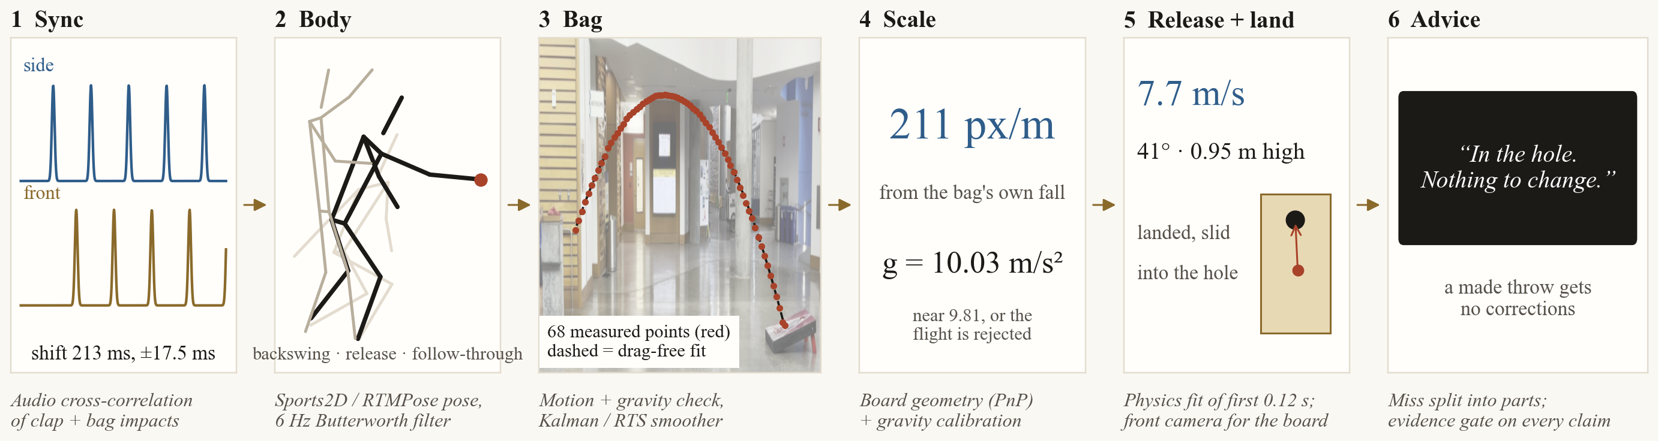
From two videos to one coaching sentence
PART 3 · HOW THE APP WORKS
INPUT
ENGINE
OUTPUT
Two videos per take
Python analysis on the Mac
What the coach sees
Side 60 fps + front 30 fps, 4 throws
About 2 min per throw, one at a time
Throw report, athlete summary, Launch Lab, PDF
One real throw through the six steps: Player 1, Take 6, Throw 1. Every number on this strip is the engine's own output for that throw.
Cornhole Biomechanics Lab
Berk Kasimcan · 8 / 17
Notes:
BERK (0:40). Here's how the app works. The input is one take: a side video and a front video of four throws. The coach drops the folder on the app, and a Python engine runs on the Mac, about two minutes per throw, one at a time. Six steps. One: pair the videos, sync them by sound, which I'll explain next, and find the four throws. Two: track 26 body points with the open-source Sports2D pose model and smooth them with a 6 Hz filter, the standard in biomechanics. Three: find the bag. A gym is full of motion, so we keep only paths that curve down like a real falling bag. That physics check throws out people walking and arms swinging, with no training data needed. Four: turn pixels into metres using the board's known size, checked against gravity: the bag must fall at 9.81 m/s². Five: compute release speed, angle and height from the first 0.12 s of flight, plus where it landed and whether it went in. Six: split each miss into parts and write one sentence, only when the evidence supports it. [Strip below the boxes: this is one real throw, Player 1 Take 6 Throw 1. Sync shifted the front phone 213 ms; the pose model finds the body; 68 bag points follow a drag-free arc; the bag's own fall gives 211 px per metre and 10.0 m/s², close to gravity; release 7.7 m/s at 41°; it landed short and slid in, so the advice is: nothing to change.]

Slide 9
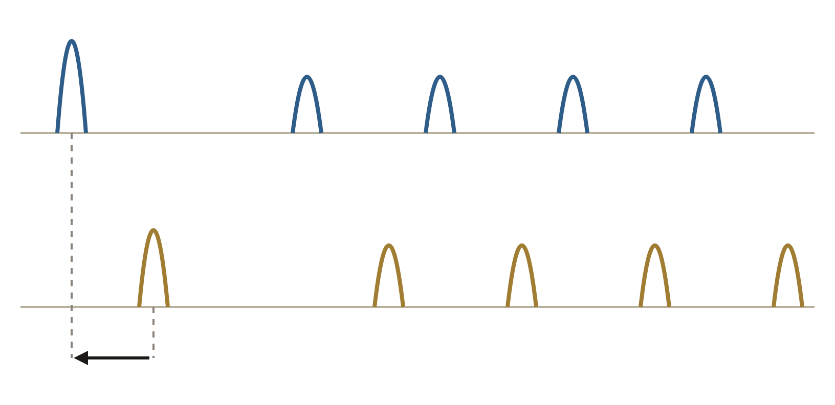
Two phones, one timeline: synced by sound
PART 3 · TWO-CAMERA SYNCHRONISATION
clap
Why it matters: the side phone measures speed and the slide; the front phone sees left/right and the hole. Combining them needs the same instant, within a frame.
Side phone: clap, then 4 bag impacts
1
Clap once at the start of each take; each bag also thuds on the board.
Front phone: same sounds, shifted in time
2
Clean both soundtracks (above 300 Hz) into a loudness curve.
3
Match the curves (cross-correlation over ±12 s); keep only a clear best match.
shift found by cross-correlation
4
Correct and check: remove the front phone's ~20 ms picture delay; check each throw's landing frame.
The app slides one soundtrack against the other until the clap and every bag impact line up.
23 / 23
takes synced automatically
±17.5 ms
about half a front-camera frame
$0
no timecode box or cables needed
Cornhole Biomechanics Lab
Berk Kasimcan · 9 / 17
Notes:
BERK (0:35). The hardest engineering problem was synchronising two phones that know nothing about each other. We need them on one timeline because the side phone measures speed and slide, while the front phone sees left/right and the hole. Our solution uses sound. The athlete claps once at the start of each take, and every bag also makes an impact sound. Both phones hear those sounds. The app filters both soundtracks above 300 Hz, turns them into loudness curves, and slides one against the other (a cross-correlation) until the clap and impacts line up. It only accepts a clear best match. Then it removes the front phone's small picture delay, about 20 ms, and checks each throw's landing frame against both cameras. Result: all 23 takes synced automatically, to about plus or minus 17.5 ms, half a frame of the front camera, with no extra hardware. Alternatives we rejected: a timecode box (cost and cables), or a person clicking the clap frame (slow, manual).

Slide 10
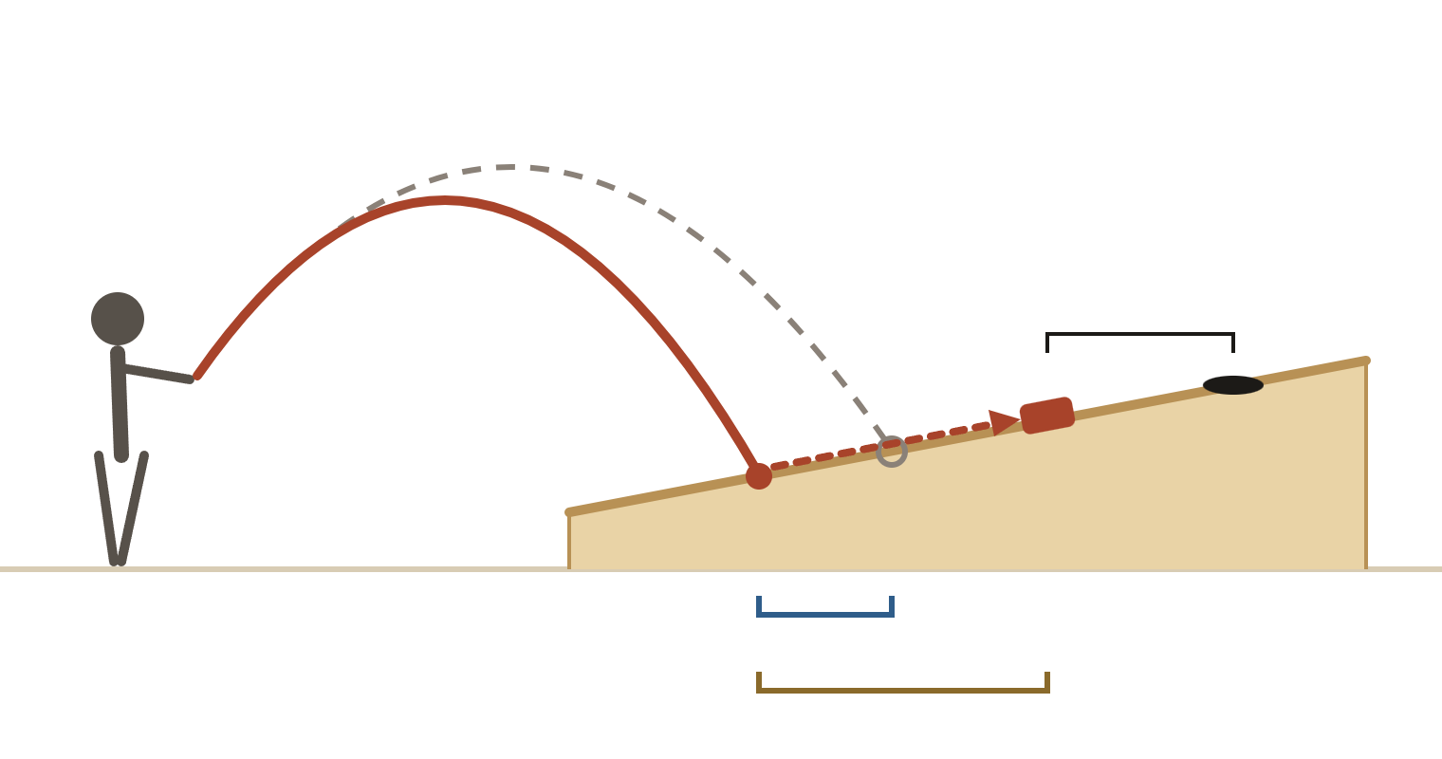
How the app turns a miss into one sentence
PART 3 · FROM A MISS TO ADVICE
Every miss is split into measured parts
WHAT THE COACH READS
“Board: 9 in short, 8 in right. Most of the short came from the carry (about 0.4 m/s slower release). Next: throw a touch harder.”
dashed = usual throw
short of the hole
The rules behind the sentence
Outcome first
A made throw gets no corrections.
Only real parts are named
carry: shorter than usual
At least 3 in and larger than its measurement noise.
slide on the board
Normal spread is normal
Inside the athlete's usual range: "keep the same throw".
Short / long = usual spot + carry + slide
Left / right = release position + aim + sideways slide
Associations, not causes
One cue at a time; never "because" or "fault".
Cornhole Biomechanics Lab
Berk Kasimcan · 10 / 17
Notes:
BERK (0:35). This is how the numbers become advice. Every miss is split into measured parts. Short or long equals where this athlete usually lands, plus the carry (how much shorter or longer the flight was than usual), plus the slide. Left or right equals release position, plus aim, plus sideways slide. Here the bag landed shorter than usual and then slid, stopping short of the hole. The coach reads one sentence, like: "Board: 9 in short, 8 in right. Most of the short came from the carry. Next: throw a touch harder." The rules: outcome first, so a made throw gets nothing; a part is named only if it's at least 3 inches and bigger than its noise; a normal-looking miss gets "keep the same throw"; and the wording is associational, one cue at a time. Now let's see it live.

Slide 11
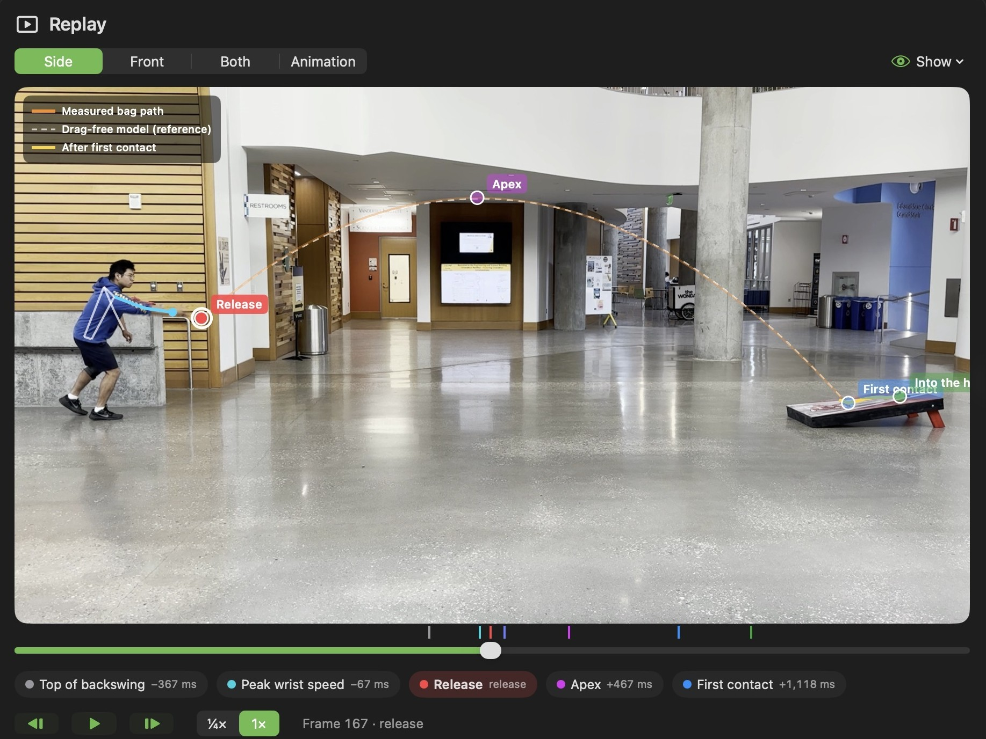
A real throw, measured end to end
PART 3 · LIVE DEMO
What we will show
1
Import a take: two videos in, synced and cut automatically
2
Replay: measured bag path, release, apex and first contact on the video
3
Throw report: the one-sentence verdict and the miss broken into parts
4
Needs Your Eye: the coach confirms only the throws the app is unsure of
5
Athlete summary: PPR, In / On / Off and the coach focus
6
Launch Lab: try a release and see where it lands
Player 1, Take 6, Throw 1: 7.7 m/s at 41°, into the hole.
Backup: a screen recording of the same steps.
Cornhole Biomechanics Lab
Berk Kasimcan · 11 / 17
Notes:
BERK (1:40). [Switch to the app.] This is Player 1, a real athlete we filmed. 1. Import: drop the take folder; the two videos are synced and cut into four throws. 2. Replay: the side video with the measured bag path in orange, the drag-free model dashed, and the release, apex and first contact marked. Toggle Front and Both to show the synced views. 3. Throw report: one sentence, for example how far short and which part of the throw it came from, and the miss breakdown with the noise band. 4. Needs Your Eye: the coach confirms only the throws the cameras weren't sure about, one key each. 5. Athlete summary: PPR 6.0, 29 percent in the hole, and the coach focus, which honestly says no release feature has separated makes from misses yet. 6. Launch Lab: drag the speed by 0.1 m/s and watch the landing move. Do not start a new analysis live; only one analysis runs at a time. Backup: screen recording. Hand over to Eliam.

Slide 12
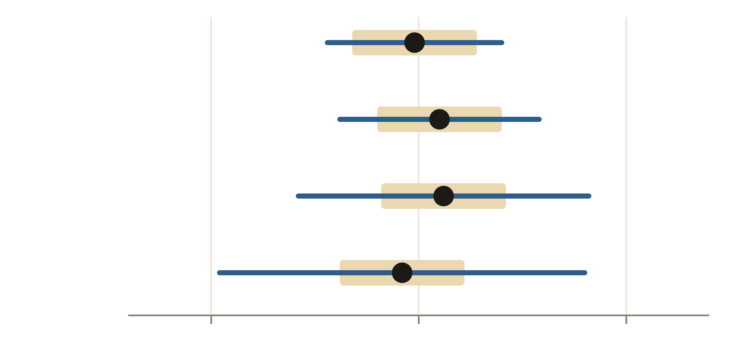
Three insights from 92 real throws
PART 4 · WHAT OUR DATA REVEALED
Release speed per athlete
Same speed, different consistency
Dot = median · bar = ±1 SD · gold band = measurement noise
All four release at about 7.5 m/s; their spread ranges from 0.21 to 0.44 m/s.
Player 1
SD 0.21
→ Train speed control, not more power.
Player 2
SD 0.24
Already at the forgiving angle
Median release angles are 37–44°, where 1° costs about 1 cm.
→ Angle drills would add little.
Player 3
SD 0.35
Many misses happen after landing
Player 4
SD 0.44
The slide was named 31 times; the carry 23 (44 explained misses).
→ Practice board feel; don't change the arm after a bad slide.
7.0
7.5
8.0 m/s
Cornhole Biomechanics Lab
Eliam Chang · 12 / 17
Notes:
ELIAM (0:40). We collected 92 real throws from four athletes in 23 two-camera takes. Three findings. First, all four release at almost the same speed, about 7.5 m/s, but their consistency differs a lot: the blue bars are the throw-to-throw spread, and every one is wider than the gold measurement-noise band, so this is real variation, not measurement error. At 13 cm per 0.1 m/s, that is the biggest source of short and long misses, so the training target is speed control. Second, they already release at 37 to 44 degrees, the forgiving angle, so angle drills would add little. Third, many misses happen after landing: the slide was named about as often as the carry, so board feel deserves practice time, and the coach shouldn't change the arm after a bad slide.

Slide 13
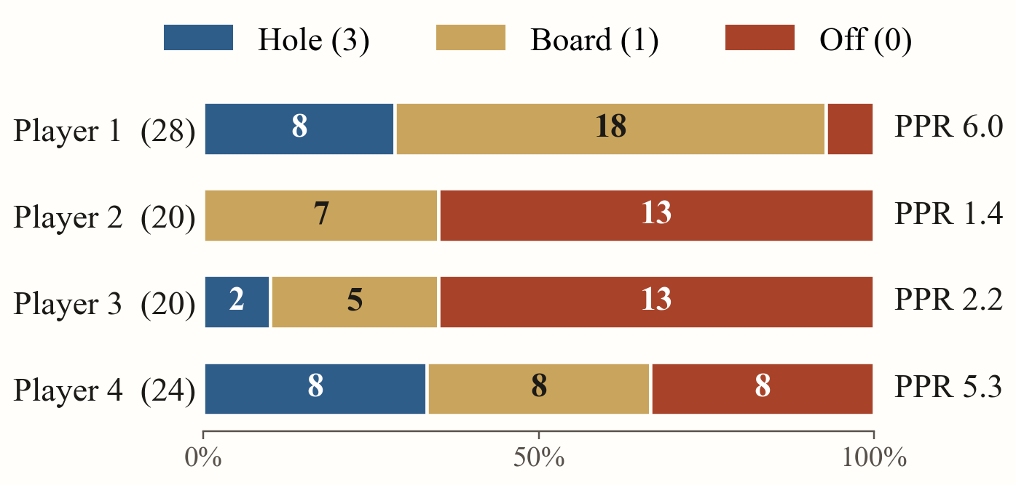
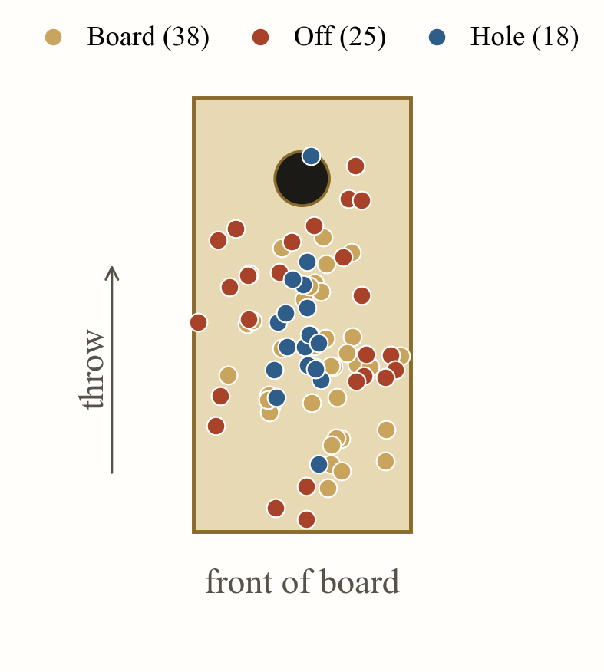
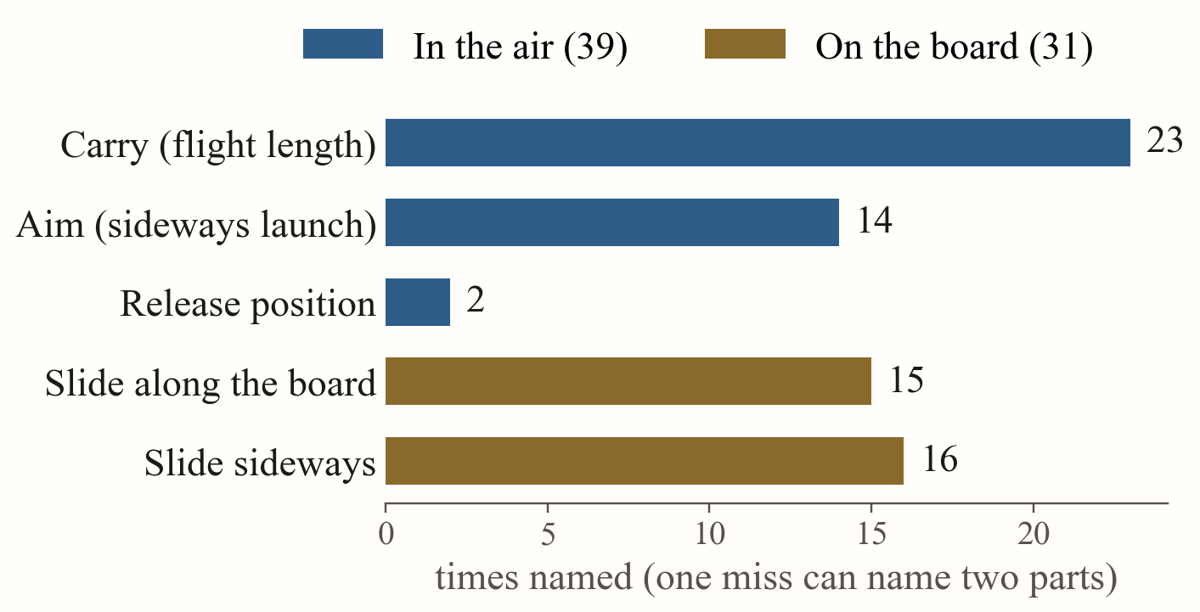
Same release, very different results
PART 4 · WHERE THE 92 THROWS WENT
First contact on the board
Outcome per athlete
Each dot is where a bag first touched (81 located).
18 hole · 38 board · 36 off. All four release near 7.5 m/s, yet PPR runs from 1.4 to 6.0.
→ Consistency, not power, sets the score.
What each miss came from
Parts the app named above noise in 44 misses. The flight (39) and the slide on the board (31) are close.
Hole shots land about 18 in short and slide in.
→ Train board feel, not only the arm.
Cornhole Biomechanics Lab
Eliam Chang · 13 / 17
Notes:
ELIAM (0:35). Here is the whole data set in one picture. Left: where every bag first touched the board. The hole shots, in blue, landed about 18 inches short and slid in, so the slide is part of a good shot. Top: outcomes per athlete. 18 in the hole, 38 on the board, 36 off. All four release at about 7.5 m/s, yet points per round run from 1.4 to 6.0, so it is consistency, not power, that sets the score. Bottom: for the 44 misses the app could explain above noise, which part it named. The carry is the single biggest part, but the slide along and across the board adds up to 31 against 39 for the flight. So practice time should go to board feel as well as release speed.

Slide 14
Why you should be convinced
PART 4 · WHY IT WILL IMPROVE TRAINING
It follows how athletes learn
The measurements hold up
1
It measures what the eye can't
Check | Result
Release frame vs video | 21 / 21 within ±1 frame
Where the bag ended | 10 / 10 tripod clips correct
Two-camera sync | 23 / 23 takes, ±17.5 ms
3D flight vs front camera | Median 0.8 in; 86% within 2 in
Model vs reality (Player 1) | 40% predicted vs 42% observed in the hole
False advice (stress test) | About 5% or less
0.1 m/s is invisible but worth 5 in. Feedback becomes numbers, not guesses.
2
It separates causes that look the same
Carry, slide, aim or release spot: each gets the right drill.
3
It fits each athlete
Compared with their own usual throw; skilled throwers succeed in different ways (Nasu 2014; Müller and Sternad 2004).
4
It doesn't over-coach
One cue at a time, only outside the normal spread, never from noise.
Not proven yet
Next: a 4–6 week within-team study, alternating weeks with and without app feedback, 40 throws per athlete per week. Outcome: PPR and landing grouping.
Cornhole Biomechanics Lab
Eliam Chang · 14 / 17
Notes:
ELIAM (0:40). Why should you believe this will improve training? Two reasons. First, it follows how athletes learn: it gives numbers the eye can't see, separates causes that look the same so each miss gets the right drill, compares each athlete with their own usual throw because skilled throwers succeed in different ways, and gives one cue at a time only when a miss is outside the normal spread. Second, the measurements hold up where we could check them: release frames within one frame of the video, the bag's end correct on 10 of 10 clips, all 23 takes synced, the 3D flight agreeing with the front camera to under an inch, the flight model predicting Player 1's hole rate at 40 percent against 42 observed, and false advice at about 5 percent or less in our stress test. To be honest, we haven't yet proven it raises scores; this study would.

Slide 15
What changes at a Vanderbilt practice
PART 4 · THE BENEFIT FOR VANDERBILT ATHLETICS
1 · Set up
2 · Practice
3 · Analyze
4 · Review
5 · Coach
Two tripods; spots marked with tape
Takes of 4 bags; one clap each
Drop the folder; ~2 min per throw
2–5 min on unsure throws only
One sentence per throw; weekly PDF
Insight → action
Practical for a team
If the app shows… | The coach can…
Speed spread above noise | Run distance ladders and speed-control drills
Miss named "slide" | Practise board feel; keep the throw the same
Miss named "aim" | Move the aim point, not the arm
A stable style profile | Leave it alone; it is how this athlete throws
"No priority yet" | Keep filming: 20–40 throws per athlete are needed
Low cost: phones and a Mac the team owns; open source, no subscription
Private: all video stays on the Mac
Little coach time: answer only the unsure throws
Recruiting bonus: a 20–40 throw session gives a repeatable profile
Cornhole Biomechanics Lab
Eliam Chang · 15 / 17
Notes:
ELIAM (0:40). What does this mean for Vanderbilt Athletics? A practice looks like this: set up two tripods, throw takes of four bags with one clap each, drop the folder on the Mac after practice, spend two to five minutes confirming only the throws the app wasn't sure of, then coach from one sentence per throw and a weekly PDF per athlete. Each insight maps to an action: speed spread above noise means speed-control drills; a slide means practise board feel and leave the throw alone; an aim miss means move the aim point, not the arm; a stable style should be left alone; and "no priority yet" means keep filming. It's cheap, private, light on coach time, and a short filmed session gives recruiters a repeatable profile, used as one input with consent.

Slide 16
What we built, what we found, what comes next
CONCLUSION
WE BUILT
WE FOUND
WHAT COMES NEXT
2 phones
13 cm
4–6 weeks
and a Mac, no sensors
per 0.1 m/s of release speed
to prove it raises PPR
A system that links the body to the release, the landing and the score, synced by sound and checked against gravity, then gives one sentence per throw.
Speed consistency, not angle or power, drives short and long misses; and the slide on the board matters almost as much as the flight.
Alternate weeks with and without app feedback, 40 throws per athlete per week, plus a blinded 20-throw validation check.
TAKE-HOME
Measure the throw. Explain the miss. Coach only what the data supports.
Cornhole Biomechanics Lab
Eliam Chang · 16 / 17
Notes:
ELIAM (0:25). To sum up. We built a two-phone, sensor-free system that links the body to the release, the landing and the score, and turns each throw into one sentence. We found that speed consistency, not angle or power, drives short and long misses, and that the slide on the board matters almost as much as the flight. What comes next is proving it raises scores, with an alternating-weeks study and a blinded validation check. Measure the throw, explain the miss, coach only what the data supports.

Slide 17
Our honest share-out
WHAT WE LEARNED
The hardest part
What surprised us
Finding a red bag on a red board in a busy gym. One tracking error spreads into the scale and every metre-based number. Fix: colour-gated tracking with four checks.
All four athletes release at the same speed; they differ in consistency. 4K video tracked worse than 1080p (0 of 10 vs 8 of 10 flights).
What we would do differently
What kept us up at night
Contrasting bag colour, 120 fps side camera, regulation distance (we filmed at 5.3–5.9 m), 40+ throws per athlete, and a left-hander.
Giving advice from noise, and no gold-standard validation yet. Our answer: the evidence gate, and a blinded 20-throw check planned in advance.
Measure the throw. Explain the miss. Coach only what the data supports.
Questions?
github.com/Berkonas/CornHoleBiomech
Eliam Chang · 17 / 17
Notes:
ELIAM (0:40). What we learned. The hardest part was finding a red bag on a red board in a busy gym; one tracking error spreads into the camera scale and every number after it. What surprised us: all four athletes release at almost the same speed, and 4K video actually tracked worse than 1080p because the bag broke into fragments. What we'd do differently: a contrasting bag colour, a 120 fps side camera, the regulation distance, more throws per athlete and a left-handed athlete. What kept us up at night: giving advice from noise, and not yet having gold-standard validation; that's why we built the evidence gate and wrote a blinded validation plan before looking at the results. Measure the throw, explain the miss, coach only what the data supports. Thank you, questions? Q&A owners: Emily (sport and coaching value), John (metrics and statistics), Berk (app, tracking, sync), Eliam (results and limits).

Slide 18
Each metric answers a different coaching question
BACKUP · INTERPRETING THE NUMBERS
Metric group | Examples | Question it answers | How to read it
Per-throw signals | Release speed, angle, height; tempo | Why did this throw miss? | Varies more than its noise (speed: 2.1×), so it can explain a single miss.
Athlete profile | Backswing, trunk lean, peak wrist speed | How does this athlete throw? | Very individual and stable (ICC 0.75–0.96): a style, not an error.
Consistency | Spread (SD) of each metric vs its noise | What should we train? | SD ÷ noise above 1 means real variation worth training.
Landing and outcome | Short / long, left / right, slide; PPR | Did it work? | Outcome first: a made throw gets no corrections.
WORKED EXAMPLE
EVERY NUMBER IS LABELLED
Player 4's release-speed SD is 0.44 m/s, 2.9× the 0.15 m/s noise floor. That alone scatters first contact by about ±58 cm. Training target: speed consistency, not technique.
Measured, estimated or unavailable, with a GOOD / WARNING / POOR grade. Missing stays missing: never a zero or a guess.
Cornhole Biomechanics Lab
John Wilson · backup
Notes:
JOHN (0:30). We ran a metric review on all 92 throws, and the metrics fall into groups that answer different questions. Per-throw signals like release speed change from throw to throw by more than their noise, so they can explain one miss. Athlete-profile metrics like backswing and trunk lean are very individual but stable, so they describe someone's style, not a mistake, and a coach shouldn't coach them away. Consistency compares each metric's spread with its noise floor: above one means real variation worth training. And outcome comes first: a made throw gets no corrections. Example: Player 4's speed spread is almost three times the noise floor, which alone moves the landing by about plus or minus 58 cm, so the target is speed consistency. Every number in the app is labelled measured, estimated or unavailable, and missing data stays missing. Next: how we collected real data to measure all this.

